Slide 1
Saxo Service Blueprint: Bridging Old and New World with Kubernetes Operators
Jinhong Brejnholt
Saxo Bank

Slide 2





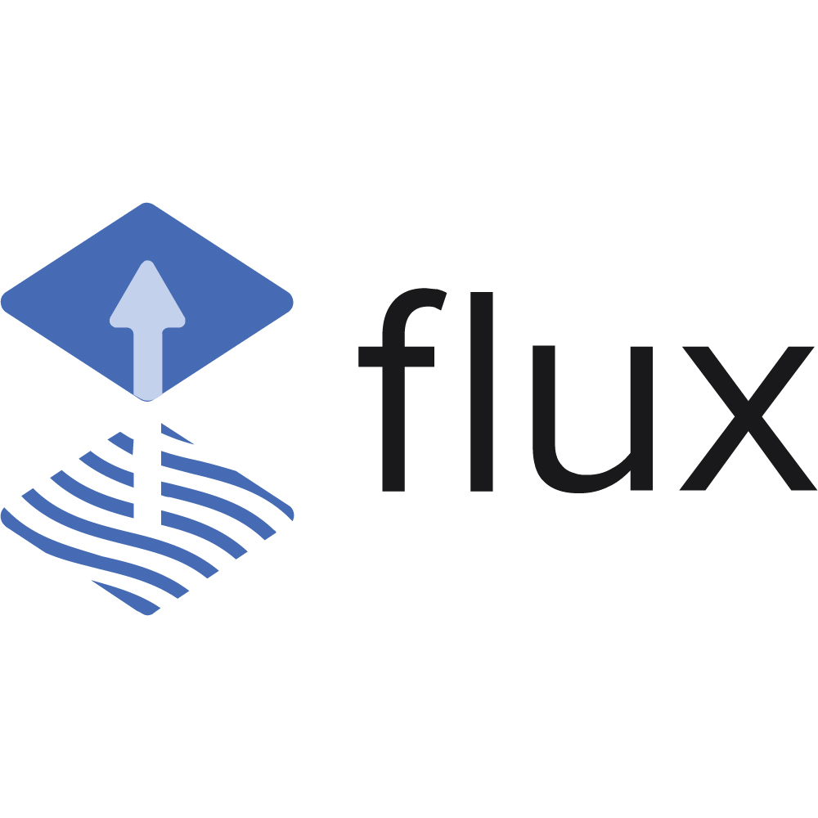


App code
Infra config
APP
jbrejnholt

Slide 3

jbrejnholt

Slide 4


App code
Infra config
APP
jbrejnholt

Slide 5
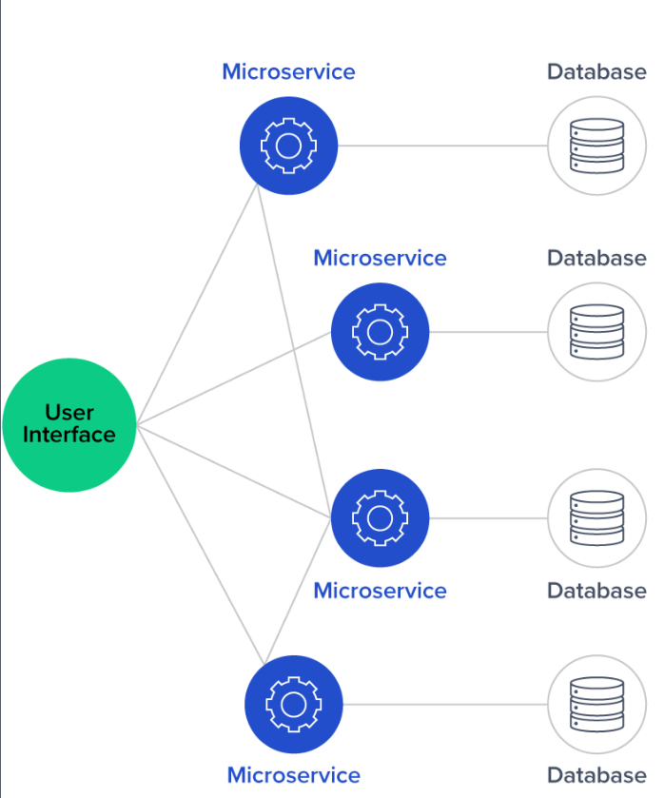
APP
jbrejnholt
Notes:
Eventually, something breaks. A routine cleanup script removes a service account that your app depends on. Suddenly your healthy pod can't talk to the database. You debug for hours. Nothing in your Git repo told you this would happen.

Slide 6

jbrejnholt
Notes:
Your confidence in GitOps starts to fade. Because what GitOps promises – predictable infrastructure through declarative code – doesn't apply to all the external dependencies your service relies on.

Slide 7

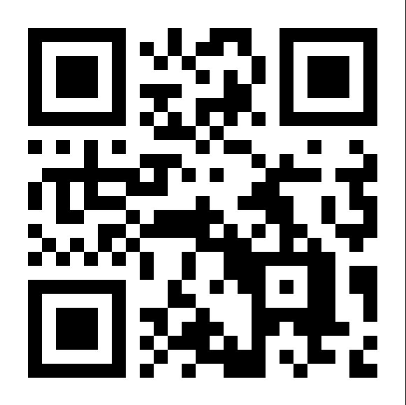
What percentage of your company’s applications are running in Kubernetes today
jbrejnholt
Notes:
Vote: https://directpoll.com/v?XDVhEthucAPpiumG9lWmFNDGyVUI8NlQqP5ZuZm
Result: https://directpoll.com/r?XDbzPBd3ixYqg89RHpyIsHwL6iZvhcfndA3lIkvVnM8e8ZFtZ

Slide 8






APP
jbrejnholt
Notes:
Other dependencies

Slide 9

jbrejnholt
Notes:
Some Developer might have lost the faith by now.

Slide 10

jbrejnholt
Notes:
But in Saxo when you say this is not possible.. You will get.. Hold my beer

Slide 11


About Us
Online trading and investment
17 billion USD daily trade
200+ banks and brokers
1.2 million clients
Euro 114 billion in client assets
jbrejnholt
Notes:
Saxo Bank is a Danish investment bank specializing in online trading and investment. It was founded as a brokerage firm in 1992, under the name Midas Fondsmæglerselskab, by Lars Seier Christensen, Kim Fournais, and Marc Hauschildt. The name was changed to Saxo when the company obtained a banking license in 2001.
Saxo Bank A/S is a fully licensed and regulated Danish bank with an online trading platform that empowers you to invest across global financial markets.

Slide 12



jbrejnholt
Notes:
What are we waiting for?

Slide 13

Cloud to Cloud Native
Multi-Cloud
Hybrid Cloud
Cloud Native
DR & Cost
Cloud-First
jbrejnholt
Notes:
Our cloud journey began with a 'Cloud First' strategy, where we explored the transformative benefits of cloud-native practices — embracing API-driven, modular, and scalable architectures.
As we progressed, we learned valuable lessons and invested significantly in disaster recovery and cost optimization. These efforts have paved the way for us to build a sustainable trading platform.
Click -> we are here. With a hybrid, and eventually multi-cloud approach, we aim to deliver a hosting environment that is cost-efficient, secure, and resilient — empowering our business to thrive in an increasingly dynamic digital landscape.

Slide 14




jbrejnholt
Notes:
Molly and I lives in a fairy tale land that we can own cars with whatever we like on – well, almost

Slide 15
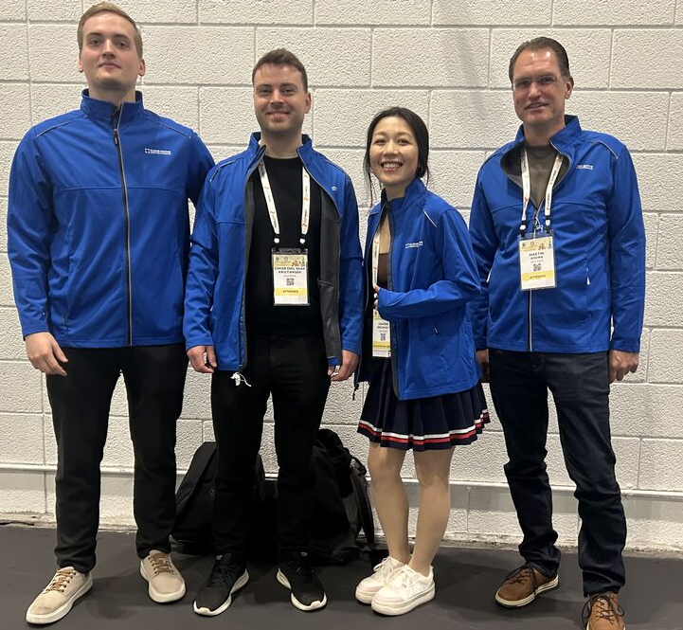
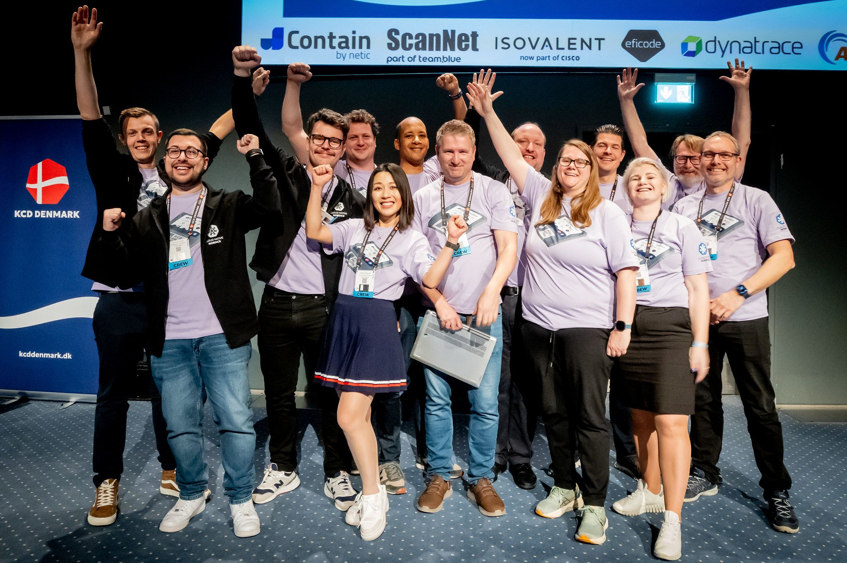

Cloud Native Community
jbrejnholt
Notes:
Encourage Saxonians to learn
Contribute to the community - org
Sharing what we learn

Slide 16
APP
jbrejnholt
Notes:
Let's go back to the mess, so how do we approach it

Slide 17

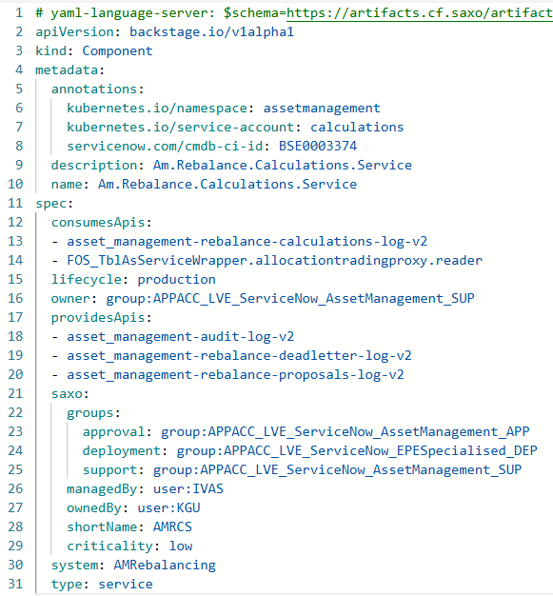
Saxo Service Blueprint
jbrejnholt
Notes:
Kibana Namespace
Kubernetes namespace
Kafka access
Access to another service

Slide 18



Saxo Service Blueprint
APP
APP
jbrejnholt

Slide 19

Saxo Service Blueprint
jbrejnholt
Notes:
Will you get to the point

Slide 20
jbrejnholt
Notes:
I'm tired of adding more animation - deal with pointer

Slide 21
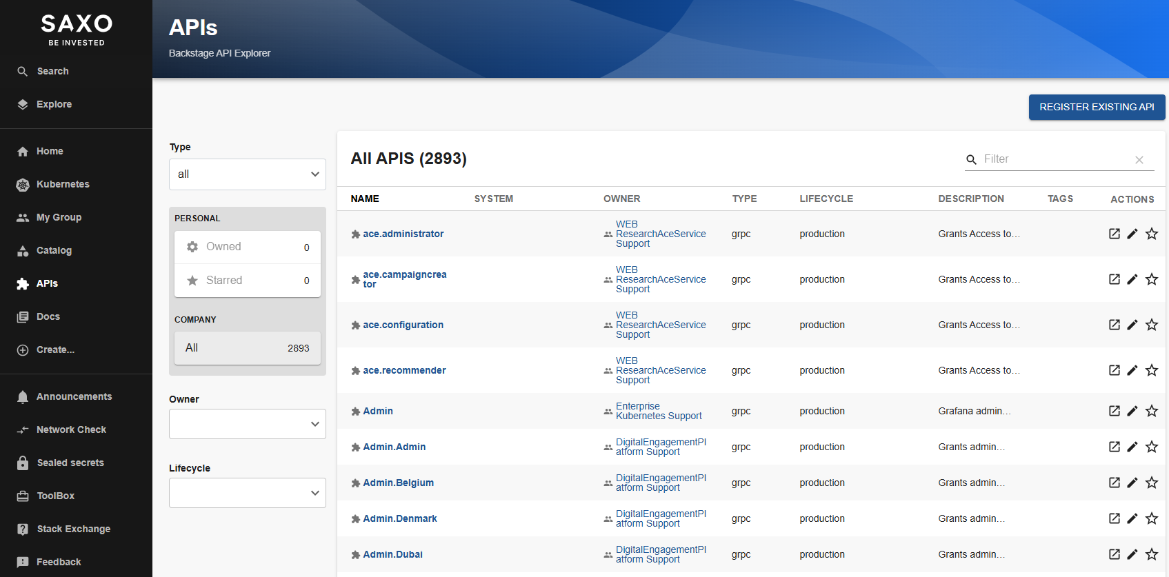
jbrejnholt

Slide 22
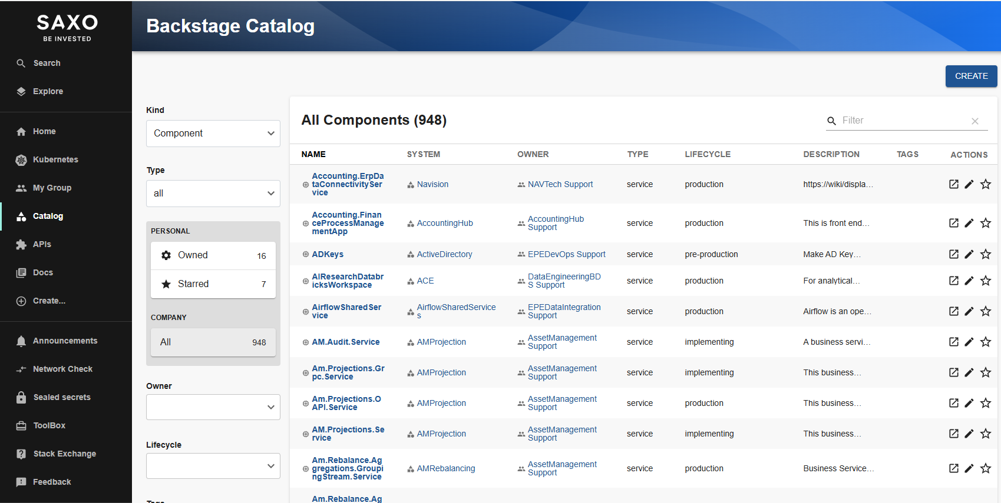
jbrejnholt

Slide 23
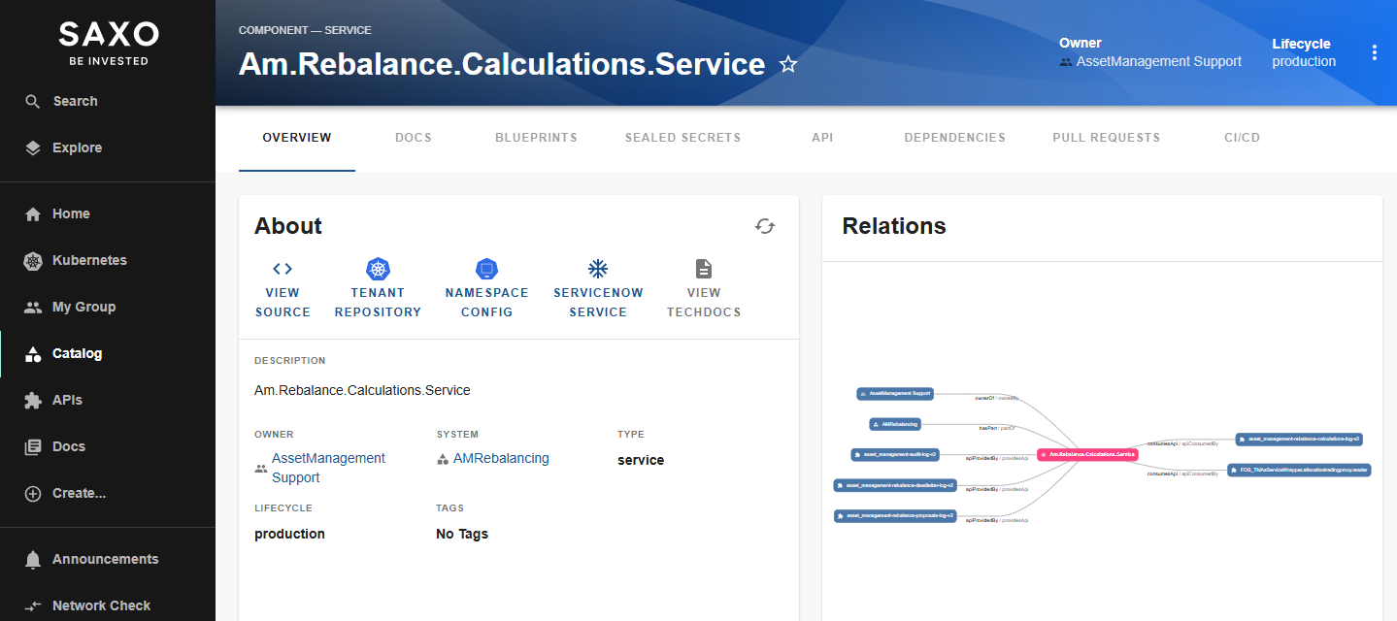
jbrejnholt

Slide 24
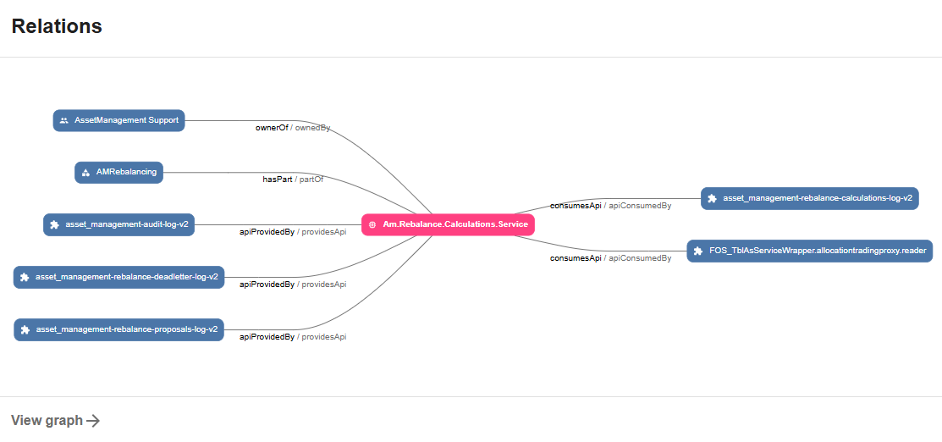
jbrejnholt

Slide 25
Notes:
Good example

Slide 26
jbrejnholt

Slide 27
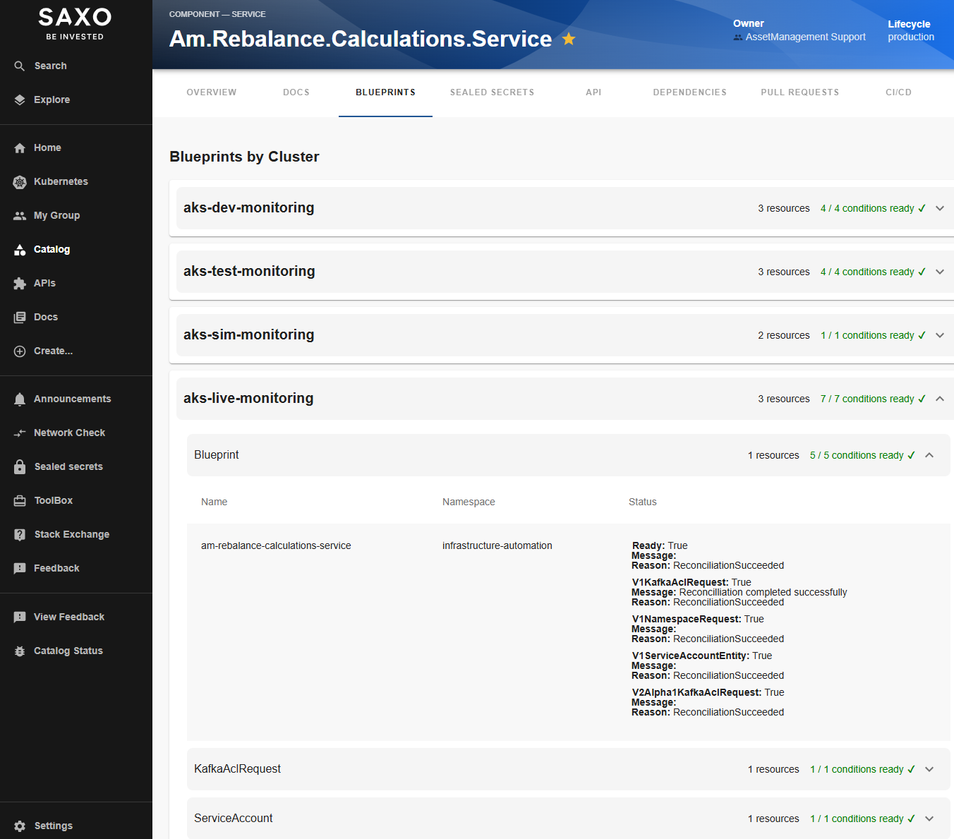
jbrejnholt

Slide 28
Role | benefit
Developer | Clarity of Requirements
Platform Teams | Automation of Provisioning
Security/Governance | Traceability & Control
jbrejnholt
Notes:
Developer Clarity of Requirements
Platform Teams Automation of Provisioning
Security/Governance Traceability & Control

Slide 29

BLUEPRINT
BLUEPRINT
jbrejnholt
Notes:
We are trying very hard to keep our developers happy with Blueprint

Slide 30
APP
jbrejnholt
Notes:
before Blueprint - don't know where is the issue and who to contact

Slide 31
App code
APP
Infra config
Blueprints
jbrejnholt
Notes:
This is where we are heading
Dependencies are also maintained

Slide 32


Learnings
GitOps ≠ App Readiness
Declared → Automate
Service-to-service trust: First-Class
Automation is a journey
Platform Developer
jbrejnholt
Notes:
GitOps ≠ App readiness
You can’t automate what you haven’t declared
Service-to-service trust needs to be first-class
Automation is a journey
Platform and developer collaboration is key
We learned these lessons the hard way. GitOps gets you part of the way, but not all the way. Especially in a regulated industry like fintech, you need stronger guarantees and systemic thinking.”

Slide 33

Don’t just GitOps your infrastructure – Blueprint your intent
jbrejnholt
Notes:
So if your GitOps setup still surprises you at runtime, maybe it’s time to take a step back and blueprint what your application truly needs.
Don't just GitOps your infrastructure - Blueprint your intent.

Slide 34


Questions
jbrejnholt

